Slide 1
Current Status of Machinetalk
Alexander Rössler

Slide 2
Overview
Machinetalk Quick Intro
Use in Machinekit
Machinetalk GSL
Machinetalk Generic
Pymachinetalk

Slide 3
What is Machinetalk?

Slide 4
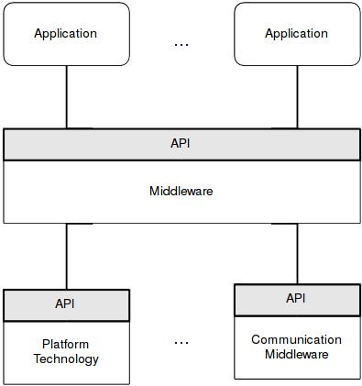
Machinetalk
Middleware
Component ↔ Component
RT ↔ Userland
Local ↔ Remote

Slide 5
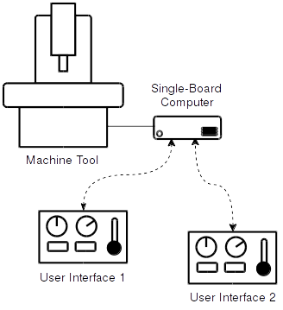
Use Case 1 – Multi UI

Slide 6
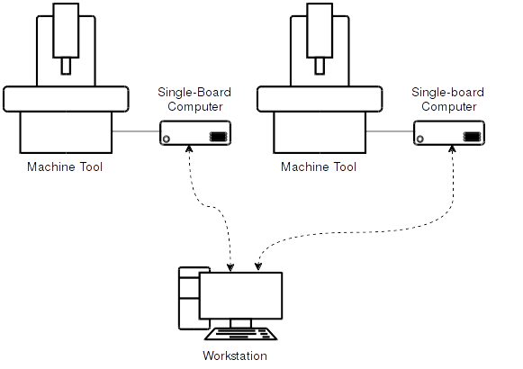
Use Case 2 – Multi Control

Slide 7
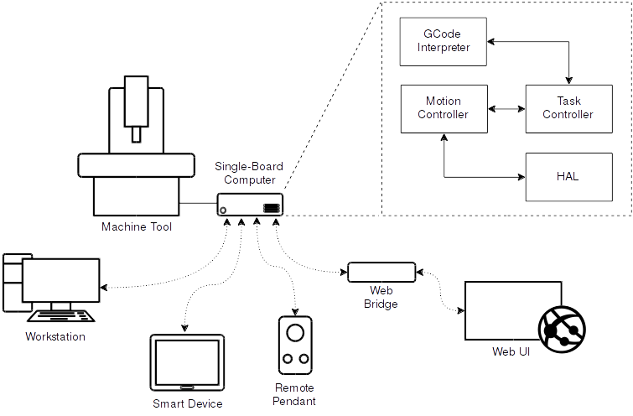
Use Case 3 – Internal and External

Slide 8
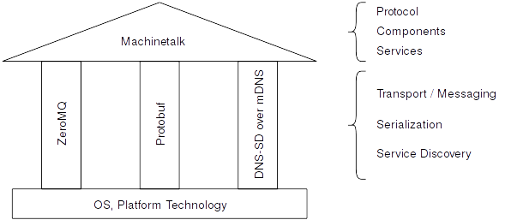
Parts

Slide 9
How is Machinetalk used in machinekit?

Slide 10
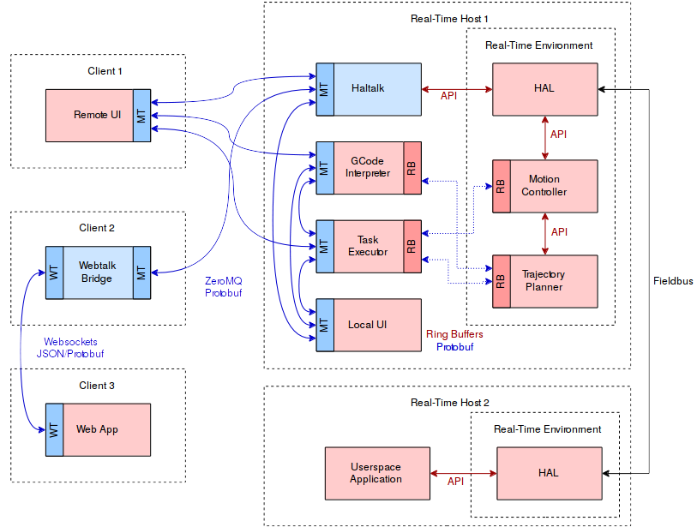
Scope

Slide 11
Services & Components
Component | Services
Haltalk | halrcmd, halrcomp, (halgroup)
msgd | log
mklauncher | launcher, launchercmd
configserver | config
mkwrapper | status, command, error, file
previewmodule | preview, previewcmd

Slide 12
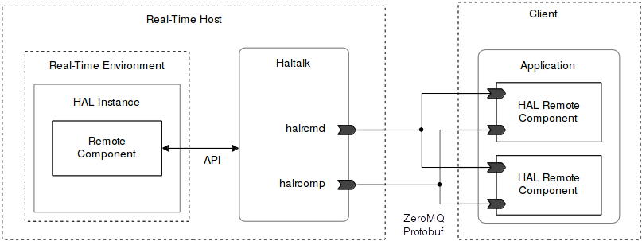
Close Up

Slide 13
What about NML?
Replace with Machinetalk
→ not completed
Major refactoring of the CNC Stack

Slide 14
What’s the deal with Machinetalk GSL?

Slide 15
Reasons
Not only Protobuf + ZMQ + DNS-SD/mDNS
Knowledge embedded in code
Repetitive across languages
Protocols better formalized
Protobuf ↔ Messages

Slide 16
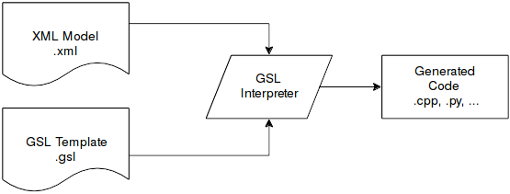
Imatix/GSL
Model Oriented Programing
Control Model + Generator

Slide 17
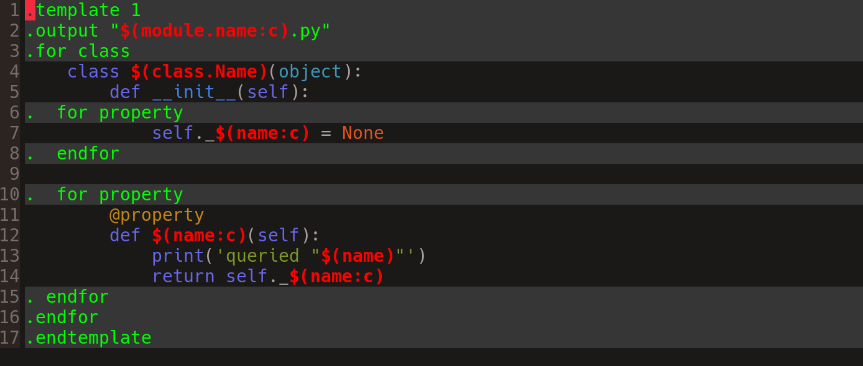
Example

Slide 18
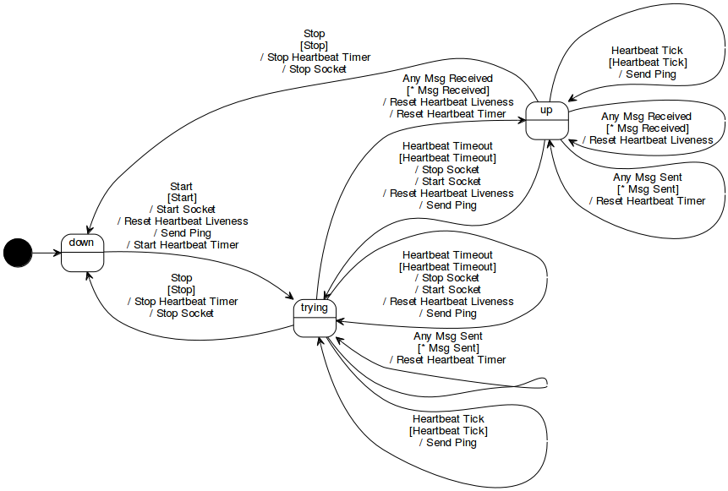
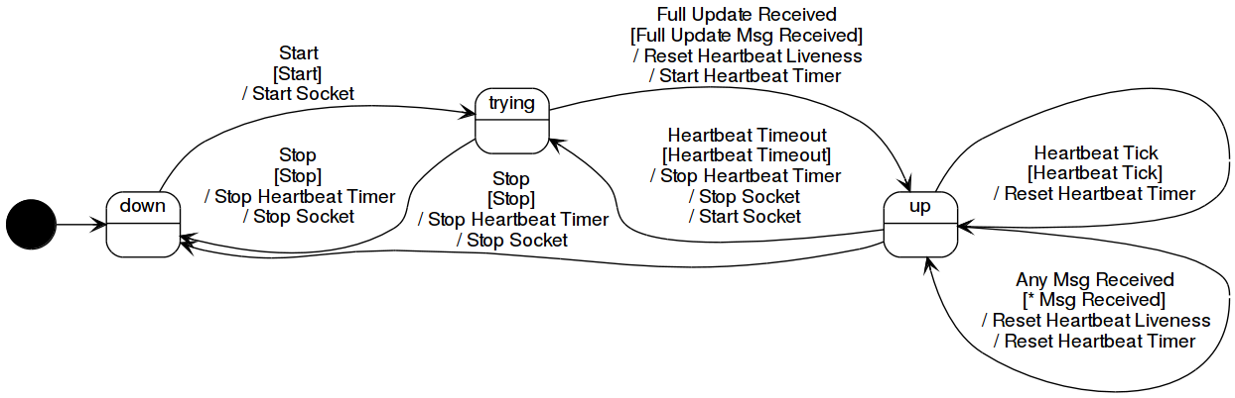
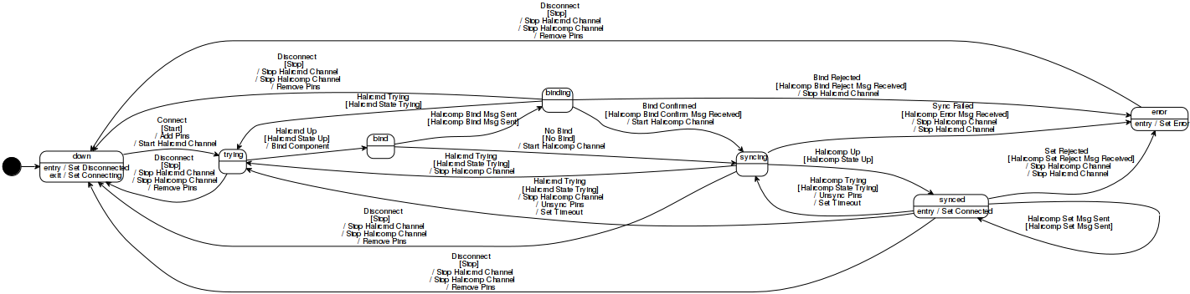
Halremote in FSMs

Slide 19
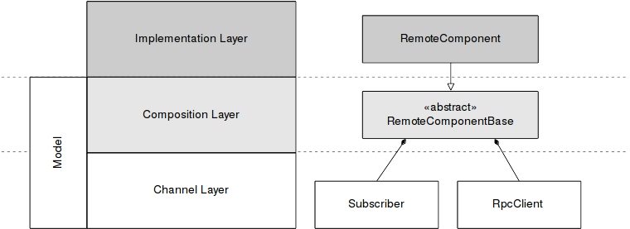
Layering

Slide 20
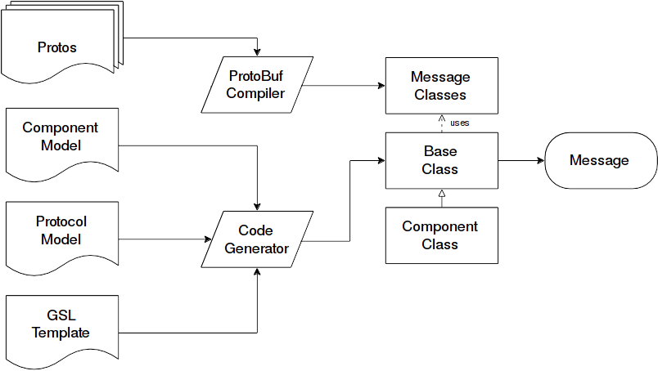
Code Generation

Slide 21
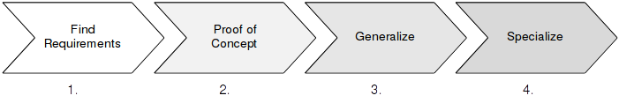
Adding a new Language Binding
Find libs
Write MVP
Build a code generator
Implement details

Slide 22
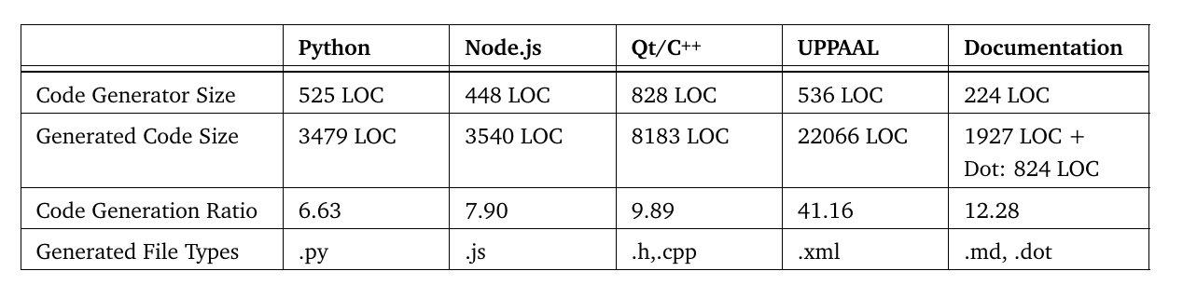
GSL Conclusion
Perfect for protocols
Less repetitive
Focus on good models
Consistency across languages

Slide 23
Applications
QtQuickVcp
pymachinetalk
WebVCP (webtalk-ng)
node-machinetalk (not in production)

Slide 24
More
Formal Verification - UPPAAL
SCXML support

Slide 25
Can we use Machinetalk for other applications?

Slide 26
Machinetalk Generic
Generalizes
  machinetalk-protobuf
  machinetalk-gsl
multiple “Machinetalks” can live side-by-side
Adds project namespace/package
Generate client and server base

Slide 27
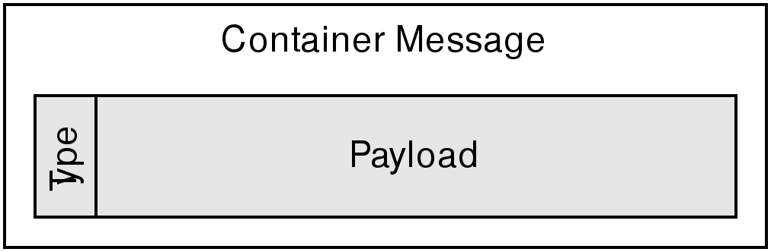
How to use
Fork machinetalk-protobuf
Fork machinetalk-gsl
Change/add project name alias
Implement your protocols
Define your message structure
Generate
Implement

Slide 28
What is the current status of pymachinetalk?

Slide 29
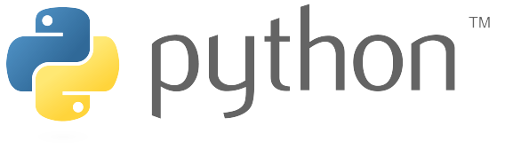
Update
Continued work
Implemented mt-gsl
Replaced avahi with zeroconf
Easier to use serivce discovery
Available via PyPI

Slide 30
Example
import time
from pymachinetalk.dns_sd import ServiceDiscovery
import pymachinetalk.halremote as halremote
sd = ServiceDiscovery()
rcomp = halremote.RemoteComponent('anddemo', debug=False)
rcomp.newpin('button0', halremote.HAL_BIT, halremote.HAL_OUT)
rcomp.newpin('button1', halremote.HAL_BIT, halremote.HAL_OUT)
led_pin = rcomp.newpin('led', halremote.HAL_BIT, halremote.HAL_IN)
sd.register(rcomp)
sd.start()
try:
while True:
if rcomp.connected:
print('LED status %s' %s str(led_pin.value)
time.sleep(0.5)
except KeyboardInterrupt:
pass
sd.stop()

Slide 31
Questions?

